Slide 1
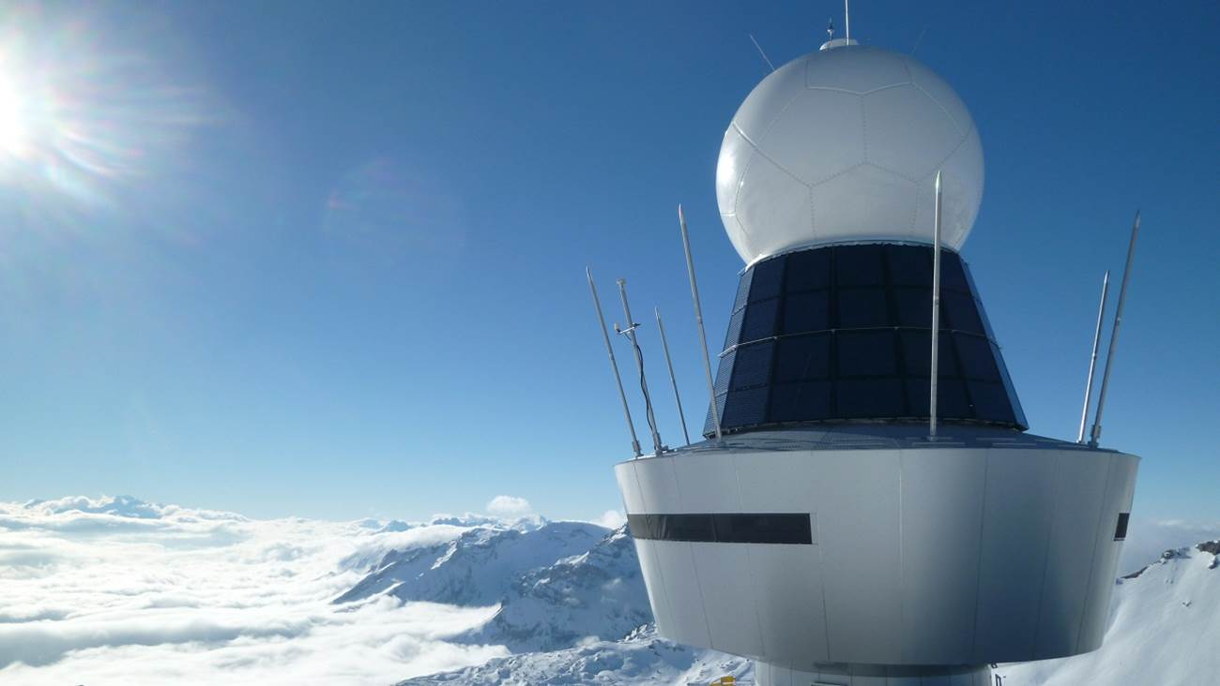
SOFTWARE PROJECT
Cristian Brugnara, Matteo Del Grande
SUPSI-DTI D2A
2023-2024

Slide 2

Introduction
The goal of the application is to provide a service to users that allows them to observe the weather in the past, thanks to various stations. These stations make it possible to generate weather statistics, graphs and make predictions of future weather conditions from the data they produce.
Notes:
We wont to bild an application that allow to to observe the the weather in the past and also we wont predict the weather condition 3-4 hour in the feature

Slide 3
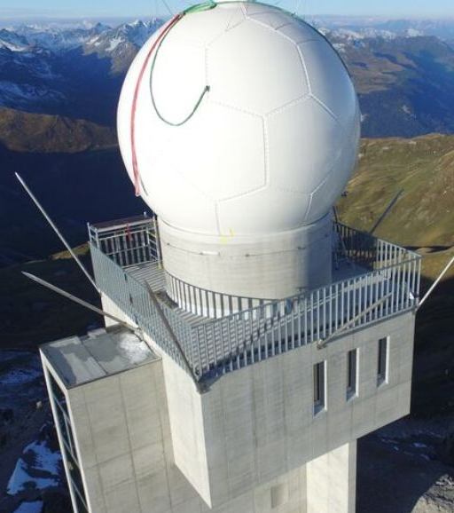






Obtaining data
Notes:
Data are produced by one or more stations
Then the data are transferred to the server
They are then used via csv, but in the future we want to implement automatic reading from the server.
The data is then put on a mongo database
and finally analysed with python

Slide 4

Offered functions
Station list
Data of the station
Specific data based on the date
Adding new data or modified them
Statistics (Min, Max, Std, Mean)
Graphs (Box-Plot, hostogram, Scatterplot, …)
Time Series

Slide 5
Problems encountered
How to save the data
Saving data in CSV file required a lot of memory, while a relational database isn’t suited to the data.
So we decided to use Mongo DB such that in the feature the server could give us data in Json format.
Time series
They require equally distributed data, so if the user removes a measurement we need to start the training after it.
We need also to learn them.

Slide 6

Conclusions
At the end of the project, the application should be able to provide specific weather information based on the selected location.
Note that only one station is used in this project, but the application is built to handle multiple stations.

Slide 7

Q&A

Slide 8

Introduction
Obtaining data
Offered functions
Problems encountered
Conclusions
Q&A

